Slide 1
Reunions

Slide 2
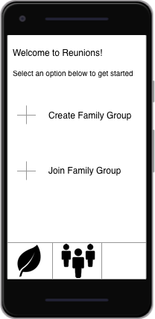
Startpage
Displays after user logs in
Offers the options to Create/Join Family groups
Leaf – Links to user profile
People – Opens list of reunions user is a member of

Slide 3
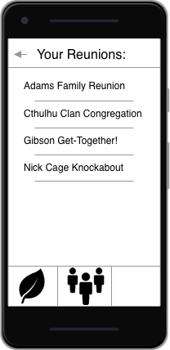
Reunion List
Easy to select a reunion
Organized alphabetically

Slide 4
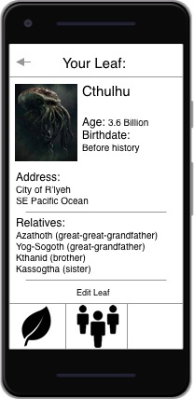
Leaf Page
The user’s profile
Contains the relevant relationship information
When joining a reunion, this data is automatically added to the Family Tree

Slide 5
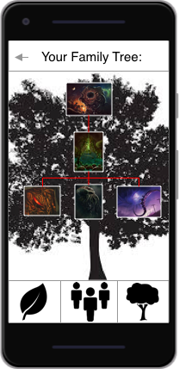
Family Tree
Live, accurate genealogy chart of reunion participants
Automatically generated each time a user joins the reunion
Tap on the picture of a family member to view their leaf

Slide 6
Credits
UI images made in Sketch
Google and H.P. Lovecraft wiki for images
Chacho’s

